Slide 1
July 31, 2026
Hari Naicker
Biweekly Meeting Recap
Dymola Optimization

Slide 2
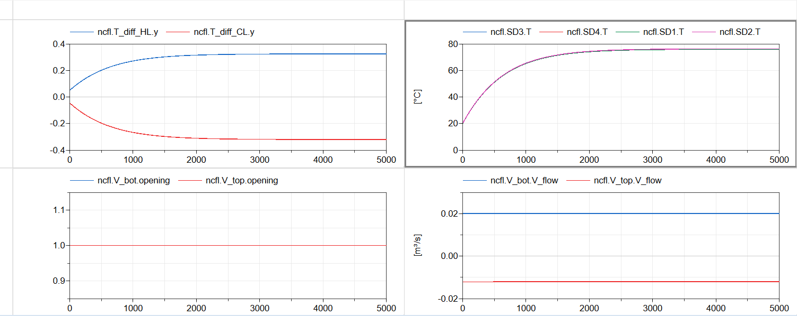

Long-Term System Stability in Dymola
Ran simulations at a maximum of 18000 seconds (5 hours) in simulated time
Reversible flow was detected at various points and rectified
  Due to mismatches in heating compared to flow rate
  Can be remedied with dynamic control of heater power based on detected mass flow in the system
System can reach steady state with nominal conditions and all valves being opened
Longer simulations with natural circulation and/or dynamic values are not stable and computation time increases drastically

Slide 3
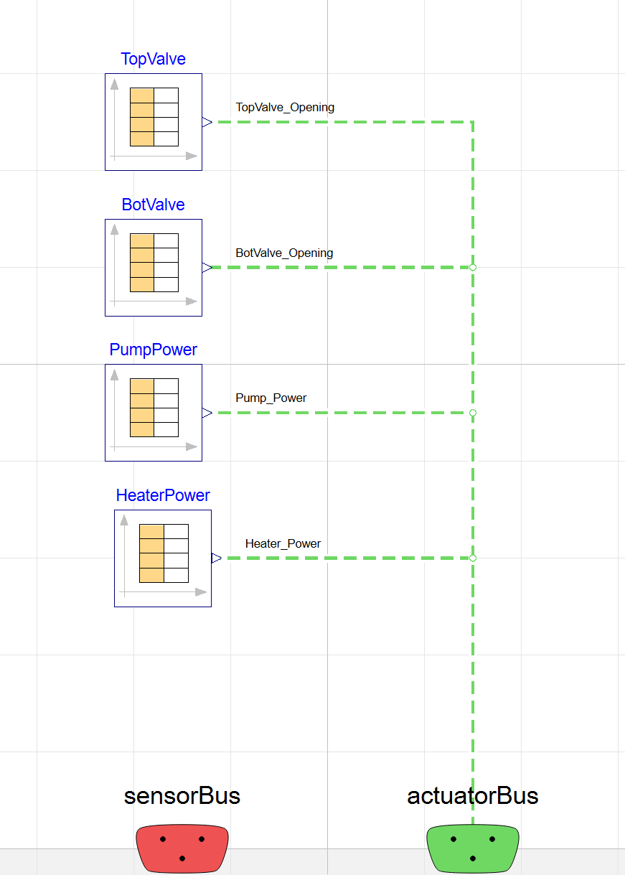
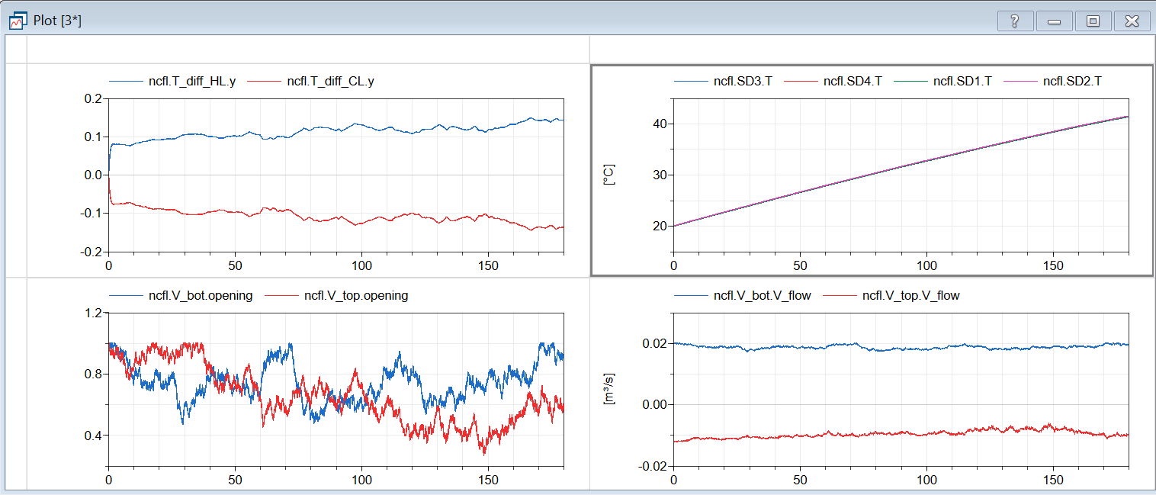
Dynamic Control
Added dynamic control
  Meant to streamline loading experimental data
Utilizes combitime tables to load external .csv data
Had issues with computational time
  Resolved by using a combination of different solvers and reduced time events
Integrated with python script to allow for external input of time series using the Python interface

Slide 4
Sensor Reconstruction and adaptive heaters
Adaptive Heating
Heaters automatically adjust based on flow rate
Did not further develop the CS for this due to current limitations in NCFL capabilities
Sensor Reconstruction
Looked through and understood nominally what Linyu’s script does
Began working on making a demo script for the discharge portion scenario
Will have to figure out how to simulate discharge, or if there is an existing discharge simulation file that I can reference

